Slide 1


Defense-in-Depth Engineering
John Poulin
@forced_request

Slide 2




John Poulin @forced-request
Current:
Manager, Product Security Engineering @ GitHub
I manage teams who hacks things
CTO, Cloud Security Partners
Previous:
Consultant
I hacked things
Software engineer
I made things that were hacked

Slide 3
Mike McCabe @mccabe615
Current:
CEO, Cloud Security Partners
Help companies with their cloud security challenges
Passionate about Infra. As Code (IAC)
Leader: OWASP NoVA Chapter
Cohost: Relating to DevSecOps Podcast

Slide 4

A04:2021 – Insecure Design
Focuses on risks related to design and architectural flaws, with a call for more use of threat modeling, secure design patterns, and reference architectures.”

Slide 5

Defense in Depth?
“Also known as layered defense, defense in depth is a security principle where single points of complete compromise are eliminated or mitigated by the incorporation of a series or multiple layers of security safeguards and risk-mitigation countermeasures.
Have diverse defensive strategies, so that if one layer of defense turns out to be inadequate, another layer of defense will hopefully prevent a full breach.”
Controls that may be overlooked
Easier to solve during design phase

Slide 6
Workshop Outline
Introduction
Environment Overview
Technical Content
Designing for Incidents
Preventing Regression
Designing for Extensibility
Understand your Libraries
Group Activity…?

Slide 7

Exercise: Environment Setup
Problem: To learn secure coding we need an application to use!
Mission:
Provide GitHub username to access repo
https://github.com/CloudSecurityPartners/skate
Utilize Codespaces or Devcontainers to run the application.
Create a codespace and connect to it locally from Visual Studio Code.
Run script/server to start the application server
This will expose the ports on the remote server and make them accessible to you.

Slide 8
Exercise: Environment Setup
Problem: To learn secure coding we need an application to use!
Mission:
Clone the App
Use Docker to run the app with a bind-mount.
Bind-mount allows us to modify contents on the container
Hints:
Clone Repo: forced-request/23-skate-roc
docker build . -t skate
docker run -d -p 3000:3000 --mount type=bind,source=`pwd`,target=/application -t skate

Slide 9

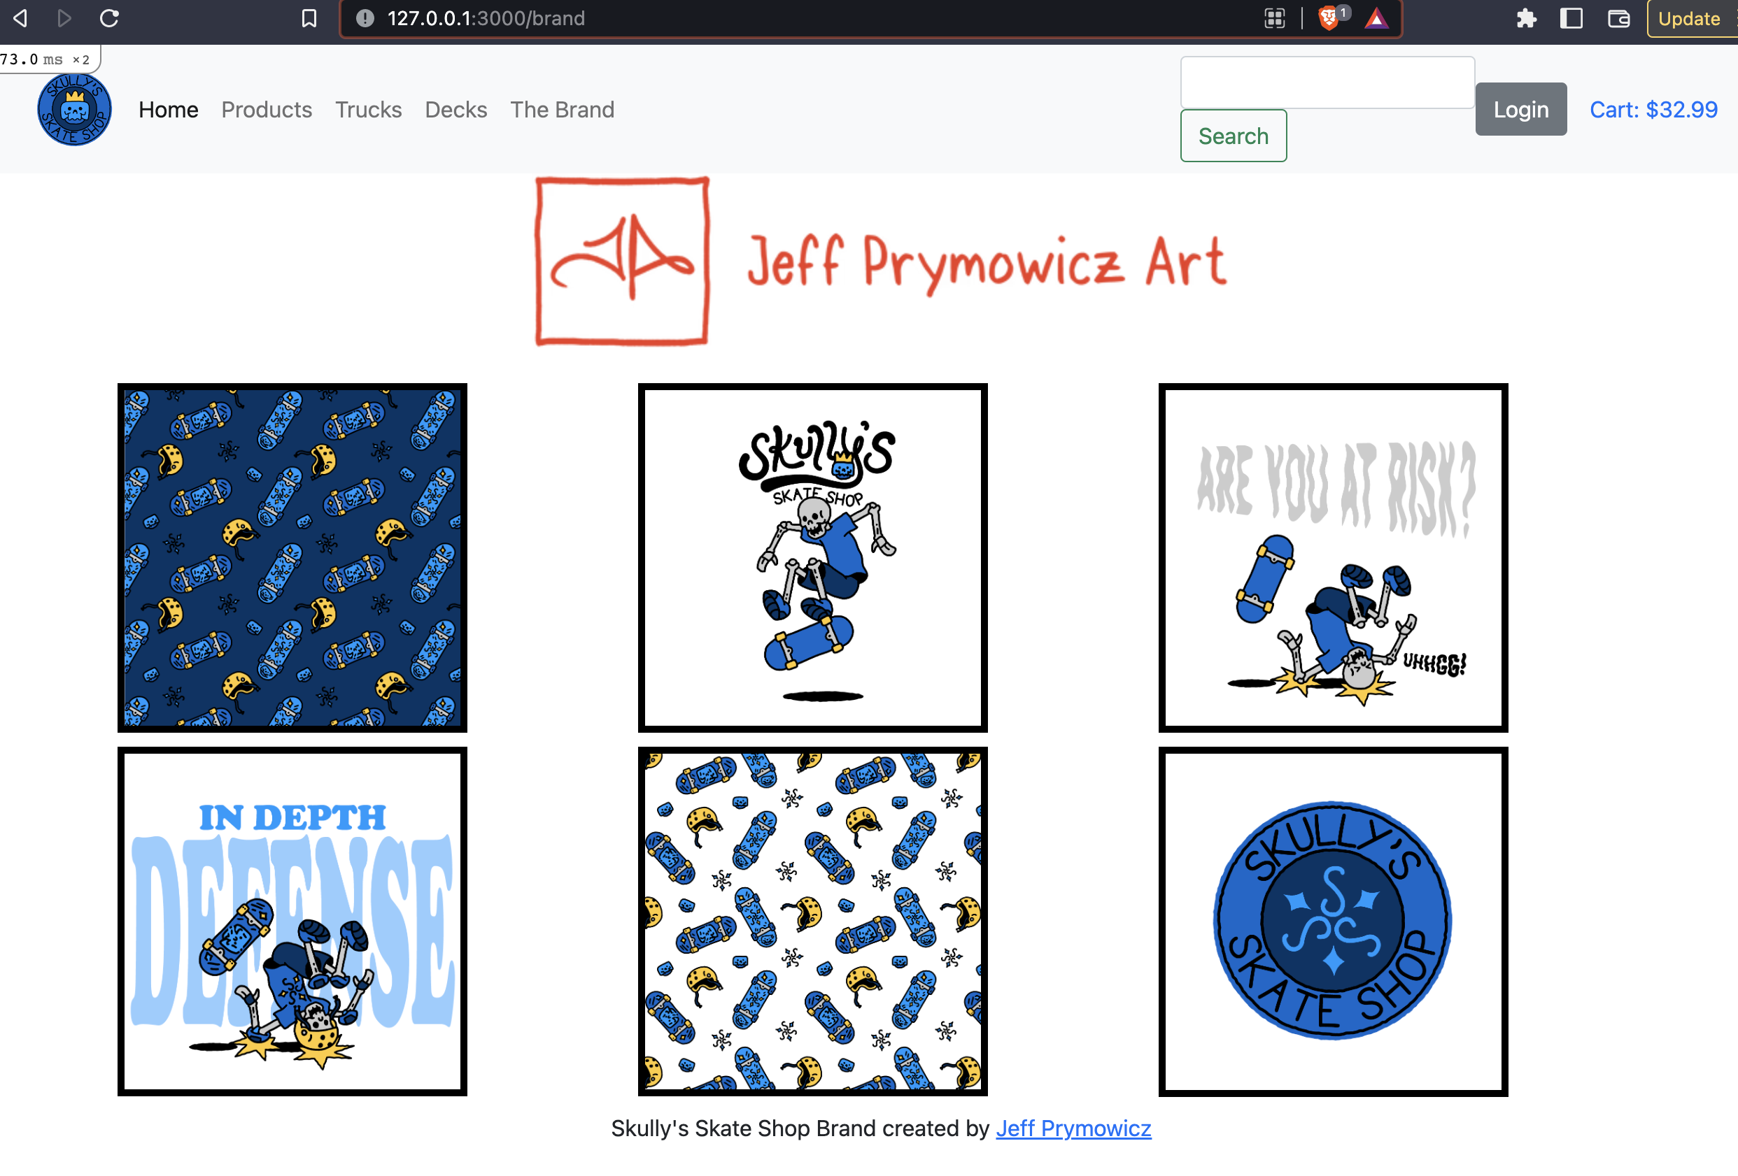
Spoiler

Slide 10
Rails Primer – File Structure
App – Most of our time is spent here.
Controllers
Models
Views
Config – Application configuration files including Routes
Routes.rb – Will cover this in depth
Development.rb – Configuration related to the environment (in our case Development)

Slide 11
Rails Primer - Routing
Config/routes.rb
namespace :admin do
resources :products
resources :product_categories
end
resources :analytics, only: [:index]
Rails routes
POST /admin/products(.:format) admin/products#create
new_admin_product GET /admin/products/new(.:format)
analytics GET /analytics(.:format) analytics#index

Slide 12
Designing for Incidents
Becoming friends with your incident response team.

Slide 13

Understand risk of the system
What is the riskiest data in your system?
Billing Info, PII, etc.
Is all sensitive data documented?
Can IR teams discover these classifications?
Are there data flow diagrams?

Slide 14
Build a plan of action
Do you have an IR team?
Without an IR team
Work with the team to understand logging desires
What data should be logged?
What data shouldn’t be logged?
How long should logs live?
Understand their expectations from engineering during IR
Will you be in the war room?
Will there be public communication?
Engineering will need to take ownership
Build playbooks to understand logging infrastructure

Slide 15
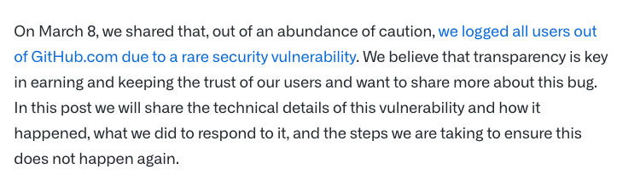
Be prepared to own the outcome!
https://github.blog/2021-03-18-how-we-found-and-fixed-a-rare-race-condition-in-our-session-handling/

Slide 16

Investigations will happen
Use the plan of action!
Build employee trust by focusing on post-mortem improvement.
Take a breath – this is a team effort
Blameless IR process

Slide 17
Exercise: Log Review
Problem: Our Incident response team need clear visibility into requests to perform investigations.
Mission:
Discover the application log files
Determine the following:
Have there been passwords leaked in search queries?
Are IP addresses being disclosed?

Slide 18

Support Customers
Customers have incidents too.

Slide 19
Supporting Customers
Customers want to know:
Providing this data:
What / When was data accessed?
Gaps in coverage means support inquiries and/or unhappy customers.
Self-Service Logs
Audit Logging
Sanitization
Dedicated playbooks for customer support team

Slide 20
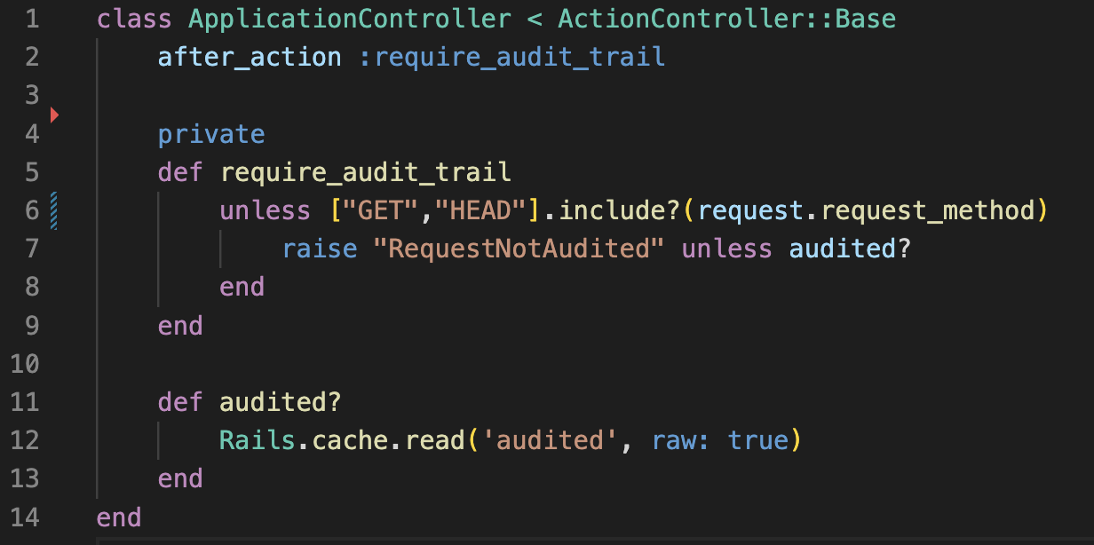
Audit all the things
Ensure every state-changing request is audited

Slide 21
Exercise: Audit Logging
Problem: Some state-changing requests are not audited
Mission:
Discover the un-audited requests
Implement Auditing
Refactor middleware to log upon failure in production
Hints:
Rails routes – generate list of routes
Look for AuditLogEntry
Rails.env != “production”

Slide 22
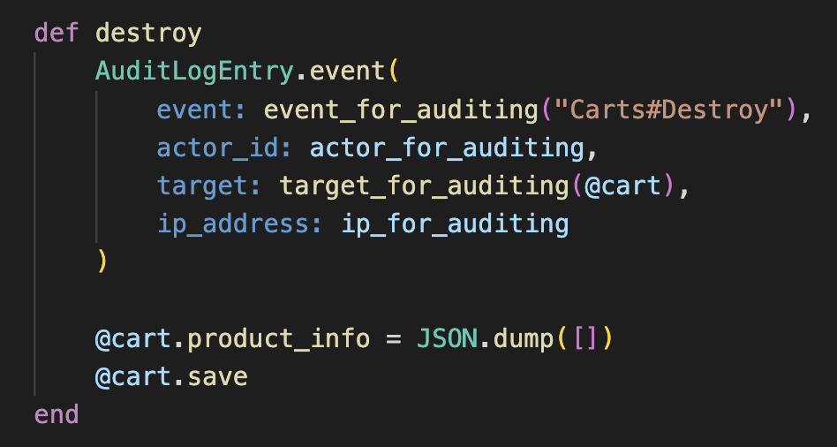
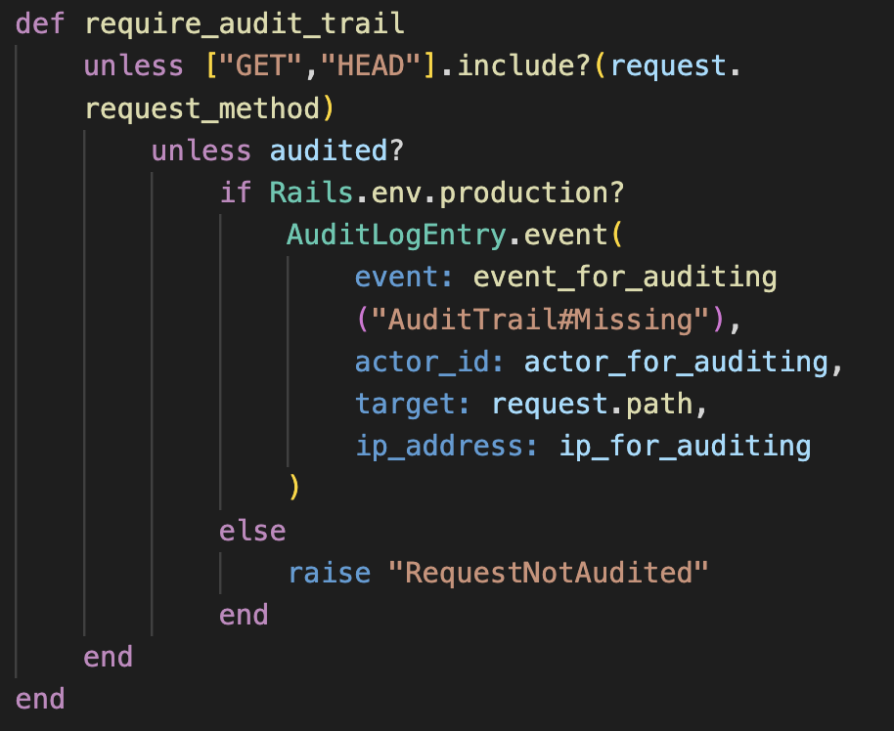
Spoiler
Mitigation Locations
carts_controller.rb
checkout_controller.rb
reviews_controller.rb
Application_controller.rb

Slide 23
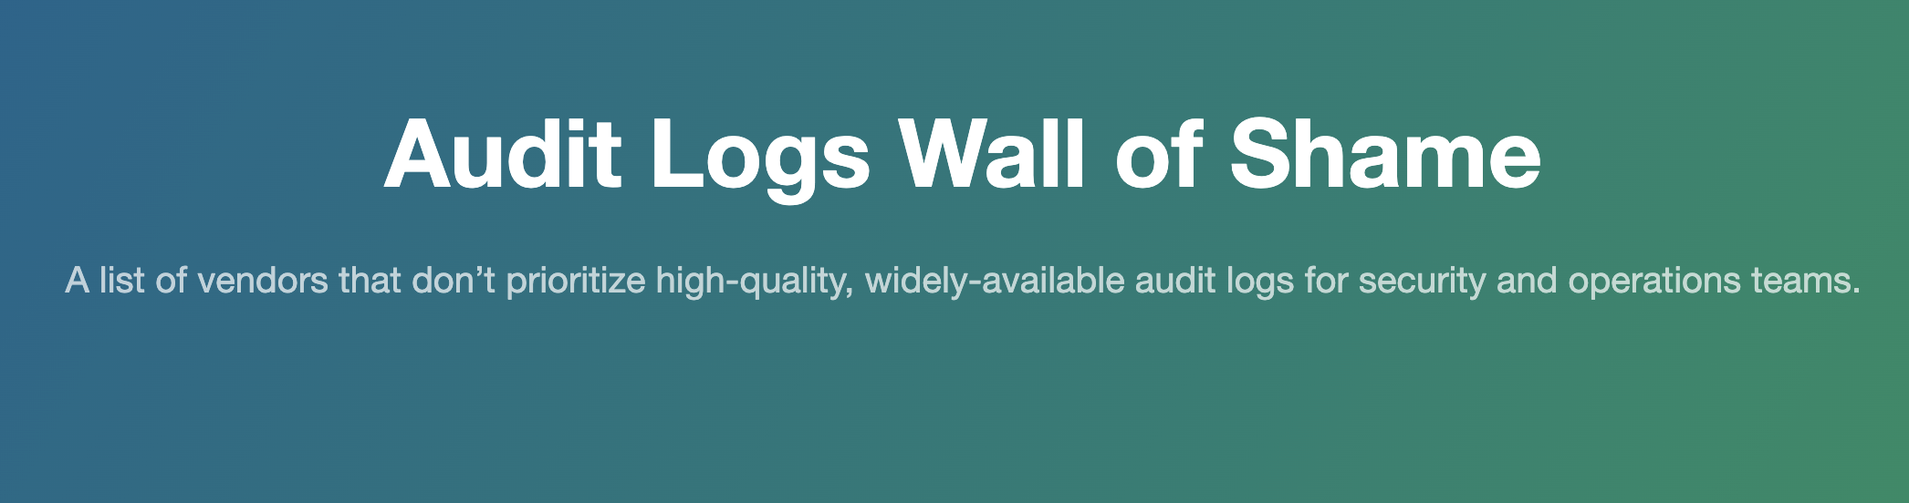
https://audit-logs.tax/

Slide 24
Preventing Regression
Never waste a good incident!

Slide 25
How can we prevent regression?
Root Cause Analysis (RCA) during IR process to drive solutions
1
Perform thorough variant analysis
2
Utilize tests to prevent regression
3

Slide 26

Ready for a test?

Slide 27
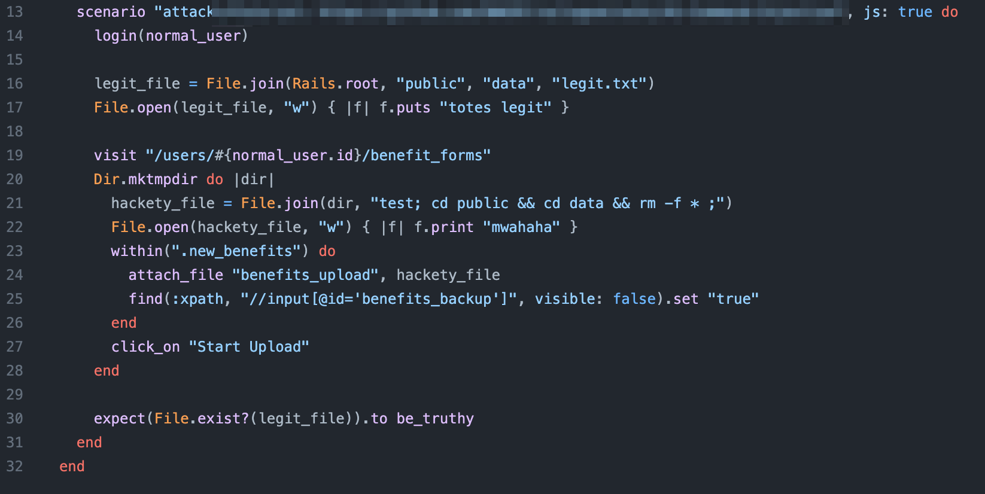
Goal?
https://github.com/OWASP/railsgoat

Slide 28
Potential Improvements
Utilize unit testing when possible, to validate underlying implementation
Consider alternative payloads
Sleep
Consider alternative encodings
URL Encoded, Unicode
Happy Path?
False Negatives?
Race Condition

Slide 29
Exercise: Test for Audit Logging
Problem: We’ve solved our audit logging problem, but we have no way to ensure we don’t regress!
Mission:
Implement a test for controllers that we’ve fixed
Ensure that audit log events are emitted.
Hints:
Revert/comment previous changes
Create integration tests, which fail.
Re-Introduce logic

Slide 30
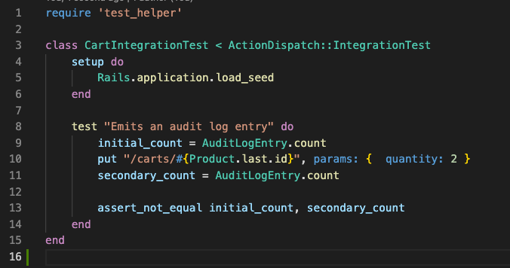
Spoiler
Create a new test for cart:
Test/integration/cart_test.rb

Slide 31
One last test

Slide 32
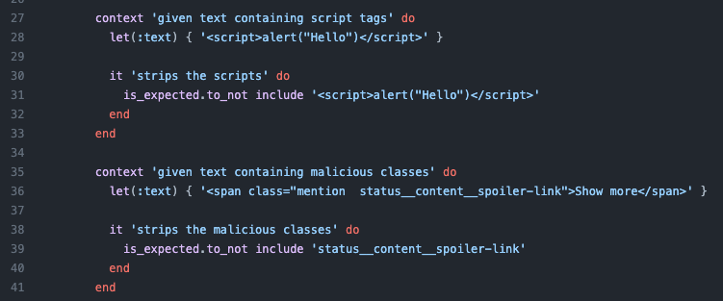
Goal?
https://github.com/mastodon/mastodon

Slide 33
Prevent rendering of script tags
What if input is lowercased, normalized, etc?
What if comparison is for equality, and not substring/match?
Are there tests for other attributes?
What about malicious ID’s?
Which are the legitimate classes?

Slide 34
Advice for designing tests
Ensure tests are utilized, and a part of the development and deployment process.
Focus test on a specific issue
Integration test XSS on user profile
Determine method to make test reusable
Can we instrument test helpers with common XSS payloads that can be reused across the app?
Establish tests as close to the logic as possible.
Unit test for validating comparison mechanisms.
Focus on testing for permutations.

Slide 35
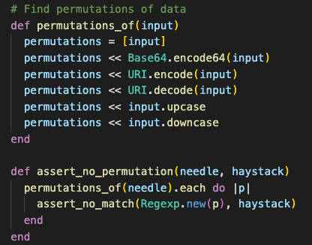
Permutations: An Easy Win
Reusable solution to test for encoding concerns
Reduce risk of input-transformation causing false negatives.
Should be used as both input and output tests

Slide 36
Designing for Extensibility
Product will change, prepare for exceptions.

Slide 37

SELECT password FROM users WHERE id=$id

Slide 38
SELECT createdAt FROM $tablename WHERE country=‘de’
What’s the solution here?
?

Slide 39
Parameterized Queries Won’t Mitigate Risk
Table name cannot be parameterized.
An alternative: allow-listing known table names.

Slide 40
Exercise: SQL Injection
Problem: The application suffers from a SQL Injection vulnerability
Mission:
Discover the vulnerability
Mitigate It
Implement a test, including permutations
Hints:
Create an allow list of table names: Products, Reviews, Carts.
Utilize before_filter to run method before controller action
Payloads include: quotes, spaces, semicolons
Payload: table=products+union+select+cost+from+Products

Slide 41
Spoiler
app/controllers/analytics_controller.rb
Utilize framework controls or middleware to introspect parameters.
Better: Additionally filter at the method level to provide better traceability.

Slide 42
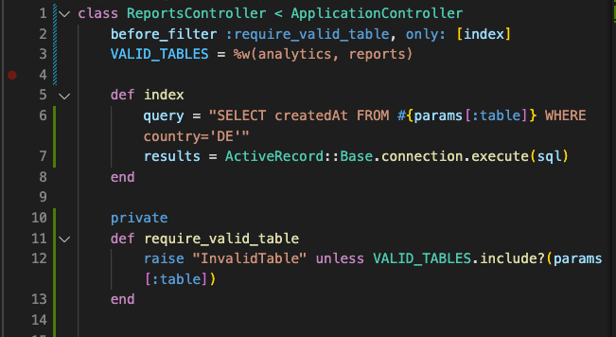
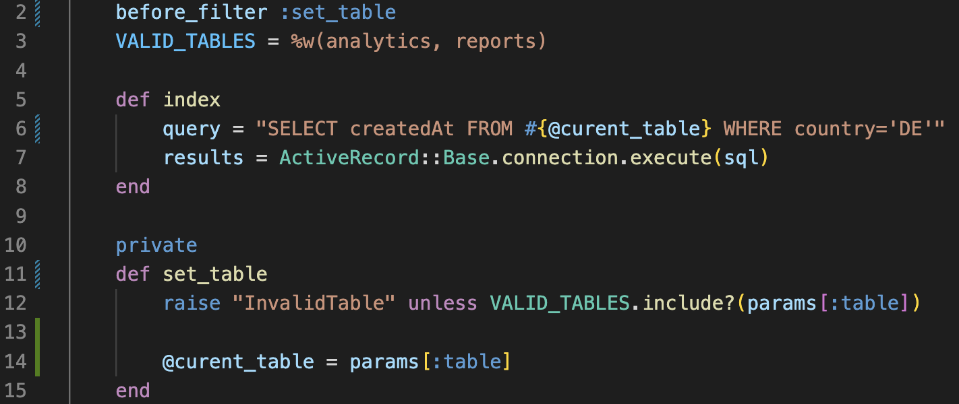
Solution
Utilize framework controls or middleware to introspect parameters.
Better: Additionally filter at the method level to provide better traceability.

Slide 43
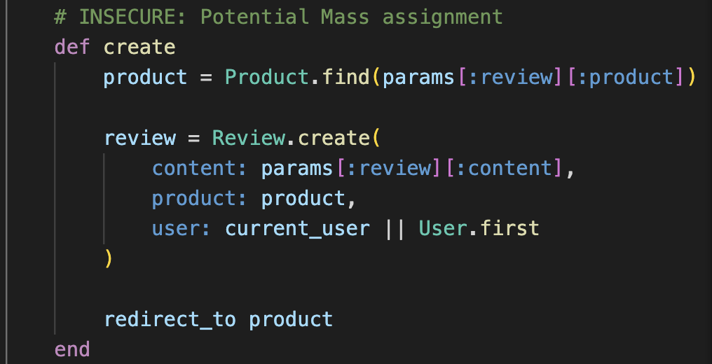
Accept the reality: insecure code patterns will be used.
Provide a supported exception process
Annotate insecure code
Link to discussion, exception, etc.
Train AI models to ignore insecure code?
Regularly review exceptions and prioritize based on risk.
Key is being able to document and audit for these decisions.

Slide 44
Exercise: Find Insecure Code
Problem: The application utilizes several insecure coding practices, and we worry that other engineers will adopt those.
Mission:
Discover and annotate insecure coding practices.
Write test case to fail if the count of these increases.
Hints:
Find anything that seems unsafe, and annotate with # INSECURE
Utilize rails notes --annotations TODO to find TODO items
Create a script that runs and counts lines.

Slide 45
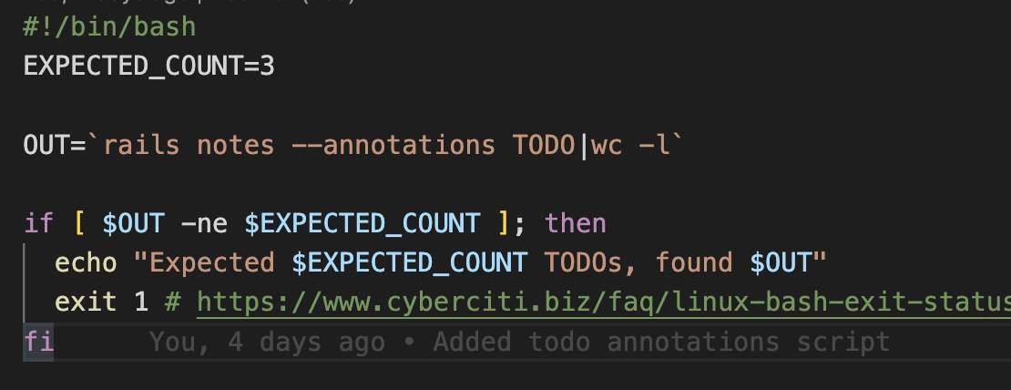
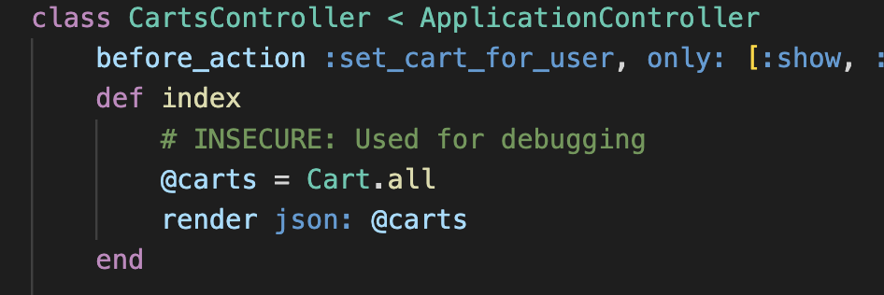
Spoiler
One example: app/controllers/carts_controller.rb

Slide 46

Build paved paths for Extensibility

Slide 47
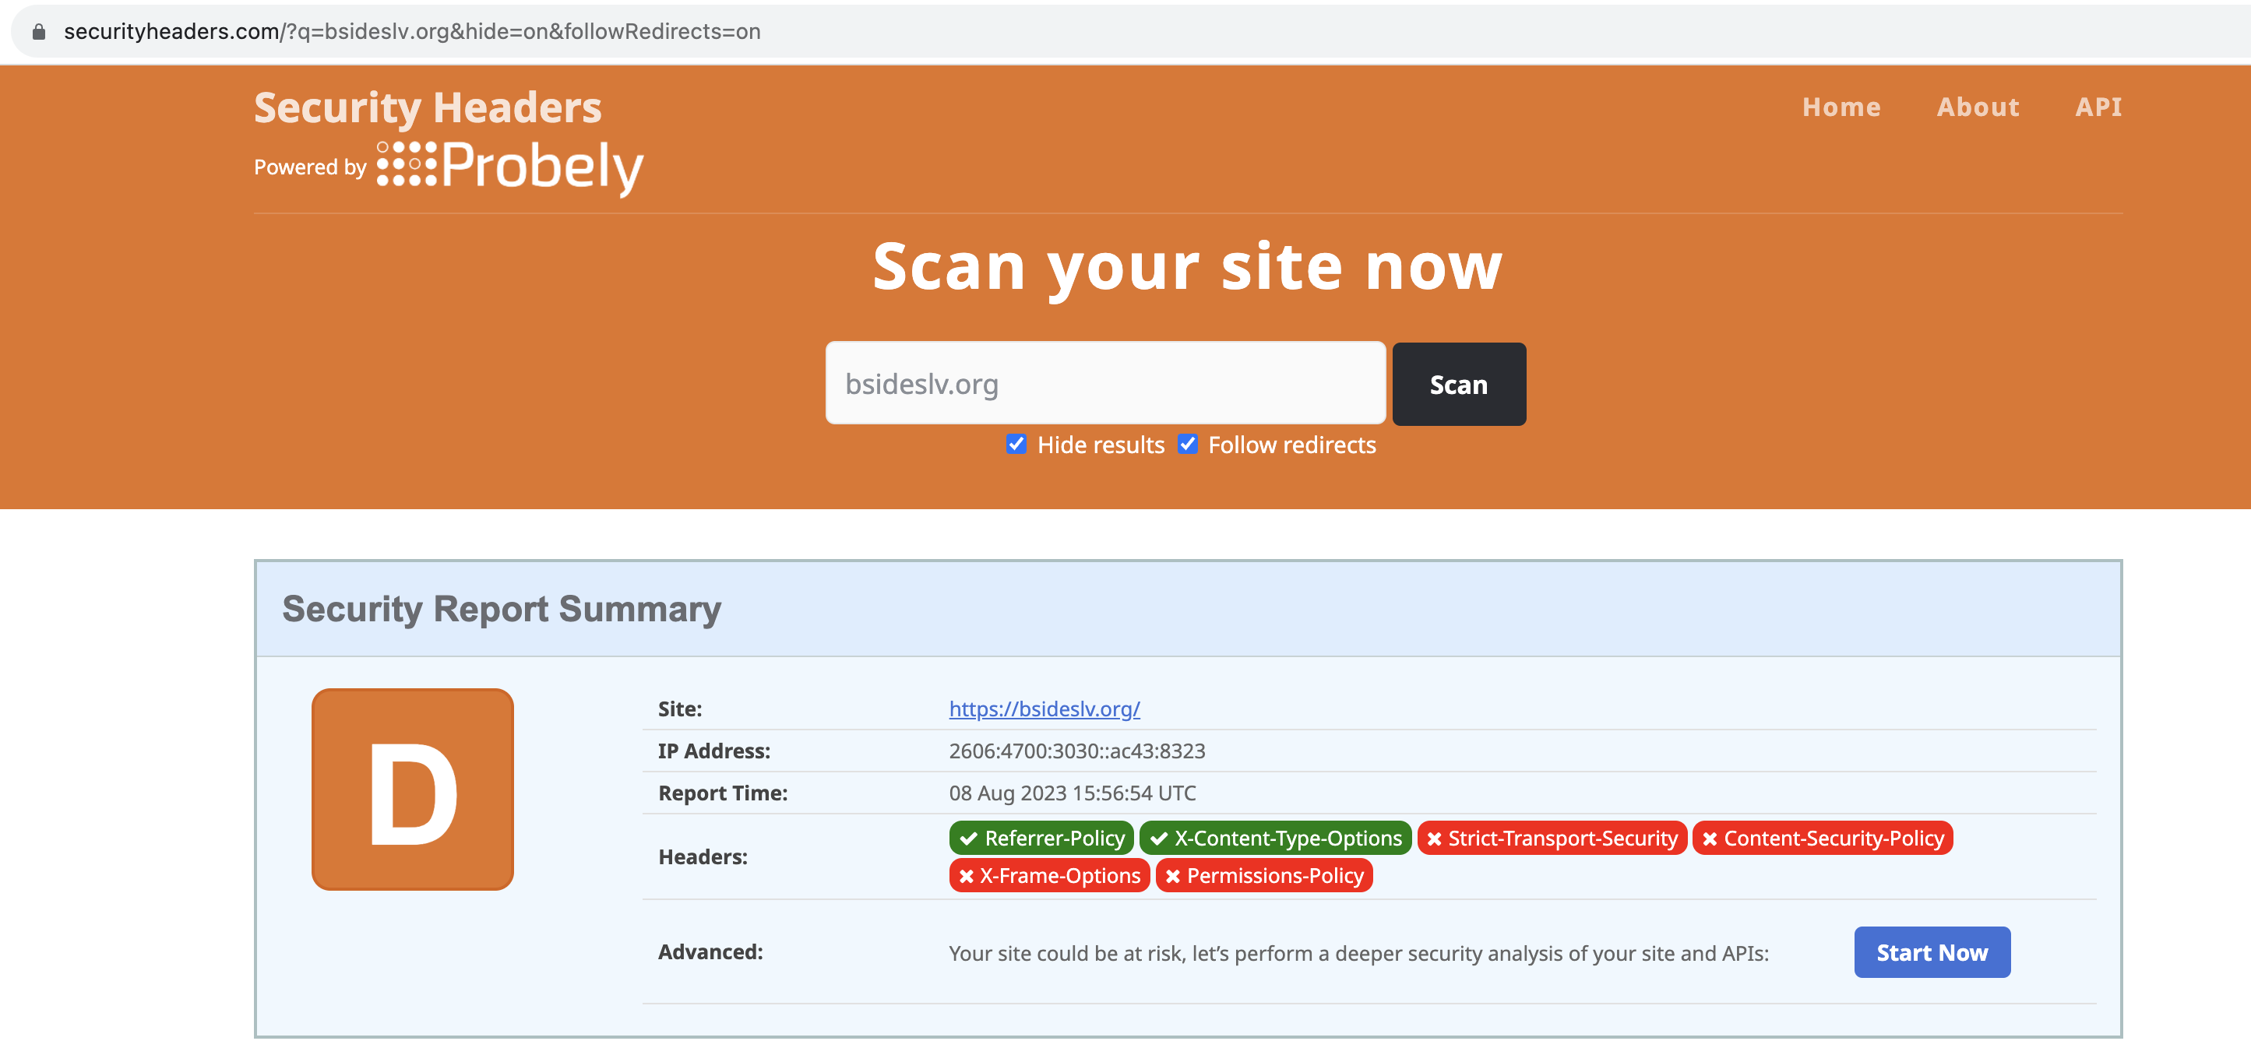
A security questionnaire favorite..
… Security Headers

Slide 48

Security headers are the new bank-grade encryption
Content-Security-Policy
Strict-Transport-Security
X-Frame-Options
X-Content-Type-Options
Referrer-Policy
Permissions-Policy

Slide 49
Content-Security-Policy
Easiest to roll out early in app. Lifecycle.
Start with default-src ‘self’ and iterate adding exceptions.
Script-src
Connect-src
Huge help in reducing the risk of Cross-Site Scripting

Slide 51
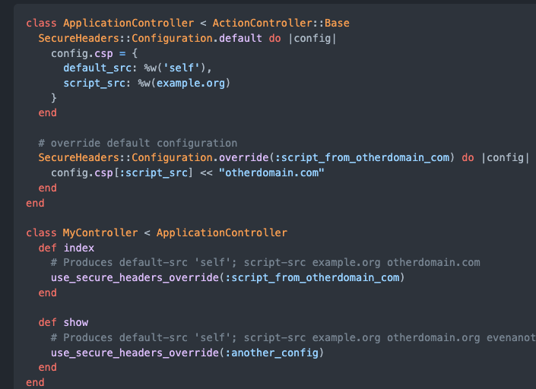
CSP can be set per-page
Utilize one site-wide, default policy
Add exceptions at a per-page basis
Exceptions should be reviewed by security.
Tighten the policy while providing developers the ability to seek exception
https://github.com/github/secure_headers

Slide 52
A clear example
GitHub.com/readme
content-security-policy: default-src 'none'; base-uri 'self'; block-all-mixed-content; child-src github.com/assets-cdn/worker/ gist.github.com/assets-cdn/worker/; connect-src 'self' uploads.github.com objects-origin.githubusercontent.com www.githubstatus.com collector.github.com raw.githubusercontent.com api.github.com github-cloud.s3.amazonaws.com github-production-repository-file-5c1aeb.s3.amazonaws.com github-production-upload-manifest-file-7fdce7.s3.amazonaws.com github-production-user-asset-6210df.s3.amazonaws.com cdn.optimizely.com logx.optimizely.com/v1/events *.actions.githubusercontent.com wss://*.actions.githubusercontent.com online.visualstudio.com/api/v1/locations github-production-repository-image-32fea6.s3.amazonaws.com github-production-release-asset-2e65be.s3.amazonaws.com insights.github.com insights-api-staging.service.iad.github.net wss://alive.github.com; font-src github.githubassets.com; form-action 'self' github.com gist.github.com objects-origin.githubusercontent.com; frame-ancestors 'none'; frame-src viewscreen.githubusercontent.com notebooks.githubusercontent.com; img-src 'self' data: github.githubassets.com identicons.github.com github-cloud.s3.amazonaws.com secured-user-images.githubusercontent.com/ github-production-user-asset-6210df.s3.amazonaws.com customer-stories-feed.github.com spotlights-feed.github.com *.githubusercontent.com images.ctfassets.net/s5uo95nf6njh/; manifest-src 'self'; media-src github.com user-images.githubusercontent.com/ secured-user-images.githubusercontent.com/ github.githubassets.com assets.ctfassets.net/s5uo95nf6njh/ downloads.ctfassets.net/s5uo95nf6njh/; script-src github.githubassets.com; style-src 'unsafe-inline' github.githubassets.com; worker-src github.com/assets-cdn/worker/ gist.github.com/assets-cdn/worker/; report-uri https://api.github.com/_private/browser/errors
GitHub.com/forced-request
content-security-policy: default-src 'none'; base-uri 'self'; block-all-mixed-content; child-src github.com/assets-cdn/worker/ gist.github.com/assets-cdn/worker/; connect-src 'self' uploads.github.com objects-origin.githubusercontent.com www.githubstatus.com collector.github.com raw.githubusercontent.com api.github.com github-cloud.s3.amazonaws.com github-production-repository-file-5c1aeb.s3.amazonaws.com github-production-upload-manifest-file-7fdce7.s3.amazonaws.com github-production-user-asset-6210df.s3.amazonaws.com cdn.optimizely.com logx.optimizely.com/v1/events *.actions.githubusercontent.com wss://*.actions.githubusercontent.com online.visualstudio.com/api/v1/locations github-production-repository-image-32fea6.s3.amazonaws.com github-production-release-asset-2e65be.s3.amazonaws.com insights.github.com insights-api-staging.service.iad.github.net wss://alive.github.com; font-src github.githubassets.com; form-action 'self' github.com gist.github.com objects-origin.githubusercontent.com; frame-ancestors 'none'; frame-src viewscreen.githubusercontent.com notebooks.githubusercontent.com; img-src 'self' data: github.githubassets.com identicons.github.com github-cloud.s3.amazonaws.com secured-user-images.githubusercontent.com/ github-production-user-asset-6210df.s3.amazonaws.com customer-stories-feed.github.com spotlights-feed.github.com *.githubusercontent.com; manifest-src 'self'; media-src github.com user-images.githubusercontent.com/ secured-user-images.githubusercontent.com/; script-src github.githubassets.com; style-src 'unsafe-inline' github.githubassets.com; worker-src github.com/assets-cdn/worker/ gist.github.com/assets-cdn/worker/; report-uri https://api.github.com/_private/browser/errors

Slide 53
Exercise: Refactor CSP
Problem: The Content-Security Policy is a bit bloated and should be refactored.
Mission:
Review CSP and discover any oddities
Begin migrating oddities from global CSP to specific controller endpoints.
Write tests!
Hints:
Server will need to be rebooted: docker exec -it skate rails restart
Find SecureHeaders::Configuration.default
Identify items that may not be required globally -- Shopify?
Create and utilize SecureHeaders::Configuration.override

Slide 54
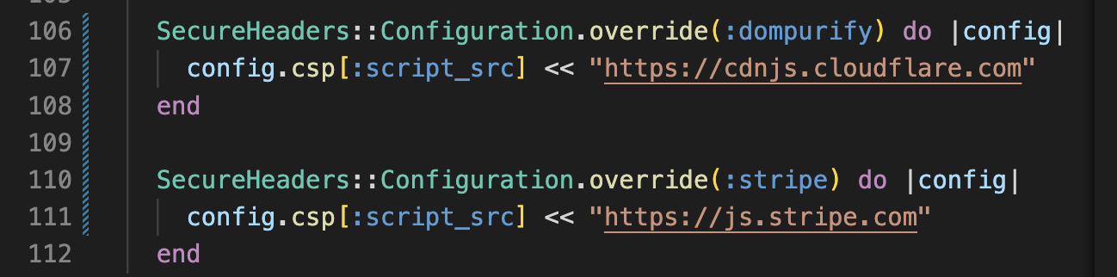
Spoiler
before_action :csp_override
def csp_override
use_secure_headers_override(:stripe)
end

Slide 55
Edge cases in XSS
Output encoding is not a silver bullet.

Slide 56
Use CSP, don’t rely on it.
“Content Security Policy (CSP) is an added layer of security that helps to detect and mitigate certain types of attacks, including Cross-Site Scripting (XSS) and data injection attacks. These attacks are used for everything from data theft, to site defacement, to malware distribution.”
https://developer.mozilla.org/en-US/docs/Web/HTTP/CSP

Slide 57
Output encoding is still key
Frameworks generally perform output encoding by default
Largest concern is with exemption (I.e., Rails’ .html_safe)
Most likely not context specific
Attribute injection is relatively common
Many WAF’s look for <brackets>
Unquoted attributes are dangerous
<p data-id=<%= params[:id] %>>
Input validation is helpful, but is defense-in-depth

Slide 58
But what if…?
We want to allow users to use some HTML tags?

Slide 59
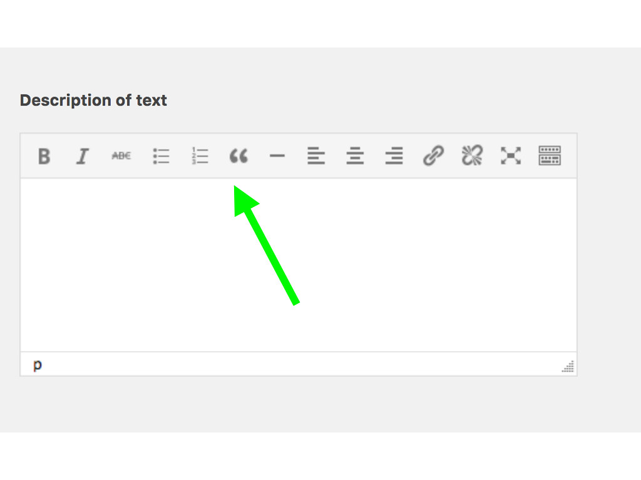
🤮

Slide 60
Goes back to exceptions
Problem:
Output encoding is likely insufficient now.
Our secure coding policies won’t work
Developers will look to the framework’s way of disabling output encoding.
Solution:
Have a plan
Identify list of tags that need to be supported
Identify list of attributes that need to be supported
Understand the context in which the tags will be rendered
Utilize a trusted sanitizer
Spend the time to understand the library

Slide 61

DOMPurify is BAE

Slide 62

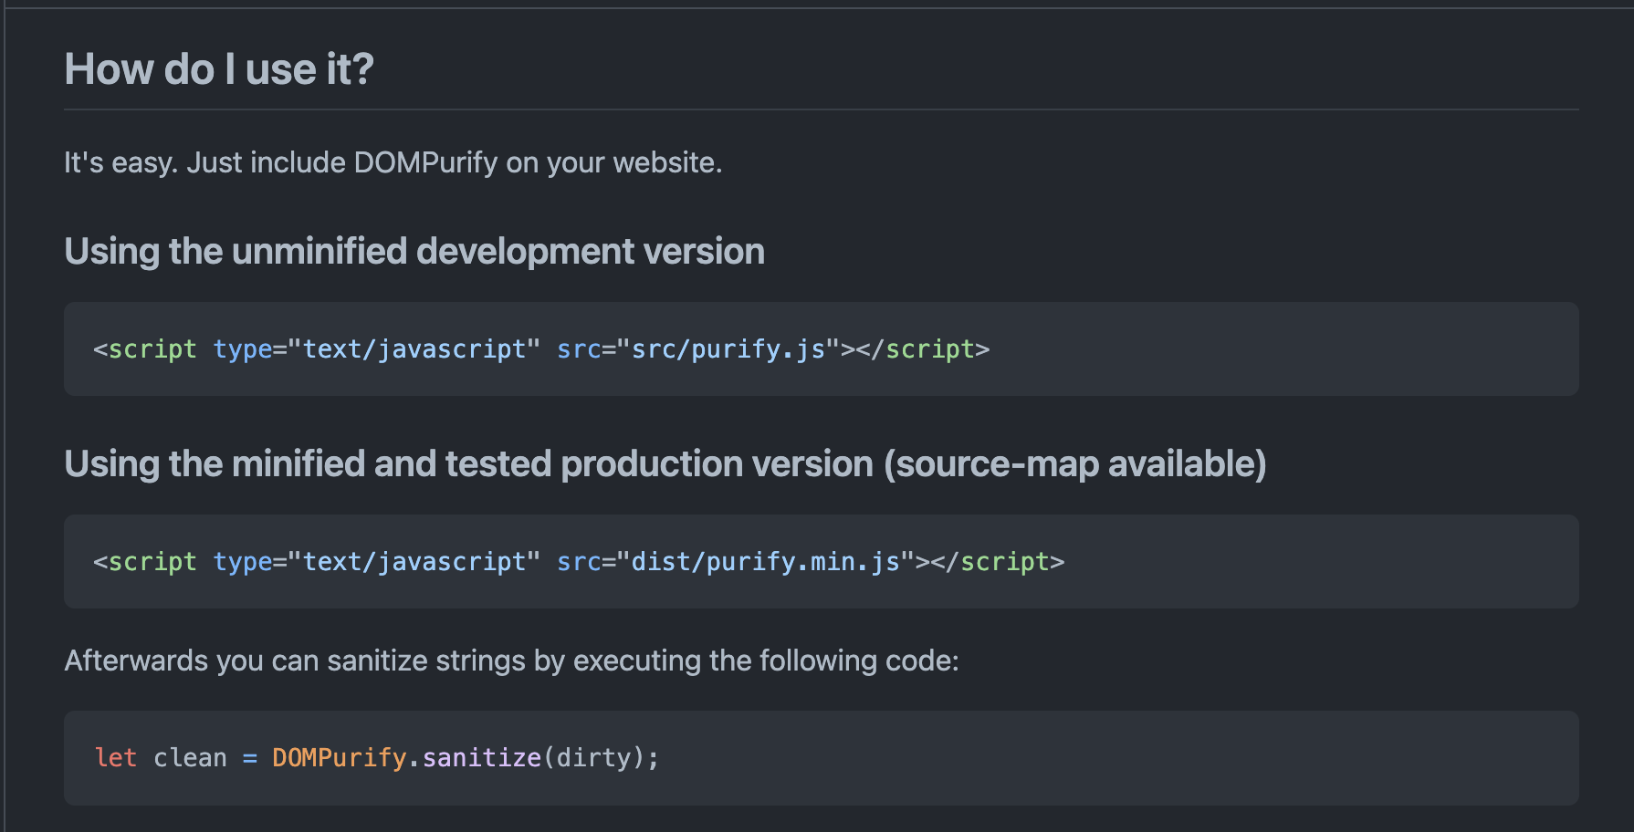

Slide 63
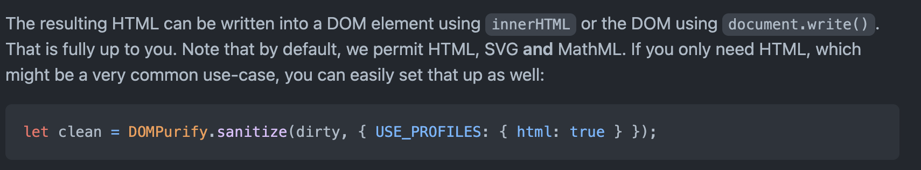
Know your libraries
“Note that by default, we permit HTML, SVG and MathML”

Slide 64
What is default behavior?
Will HTML tags be rendered as HTML, removed, or encoded??
Roughly 110 tags will be evaluated as HTML. https://github.com/cure53/DOMPurify/blob/main/src/tags.js
Are attributes supported?
Yes, over 100. https://github.com/cure53/DOMPurify/blob/main/src/attrs.js
Does it utilize an AllowList or Denylist approach?
AllowList, with ability to explicitly deny tags

Slide 65
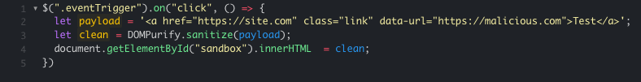
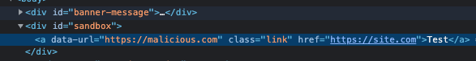
What’s the expectation?
https://jsfiddle.net/bwLokh75/17/

Slide 66

Major Takeaway
We can inject:
Classes
ID
Data Attributes
More..
Event Handlers?

Slide 67
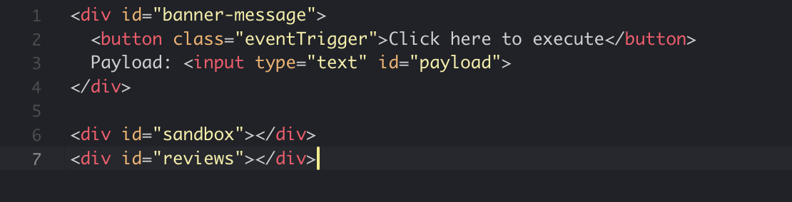
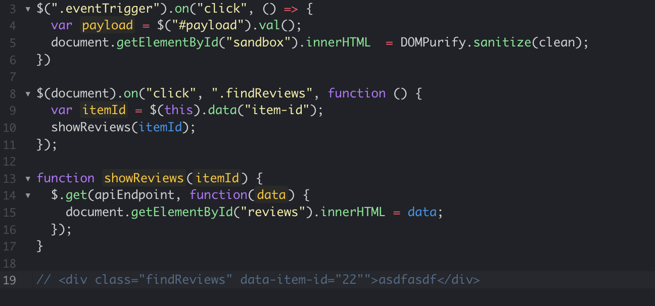
Button clicked, triggers .eventrigger
Event handler sanitizes payload, injects to the DOM.
DOM element contains findReviews class, which when clicked triggers another callback.
Invokes showReviews function
Performs HTTP request. Response is injected directly into the DOM
https://jsfiddle.net/1ntcuvLx/53/

Slide 68
DOM XSS is nearly impossible to investigate

Slide 69
Exercise: Implement DOMPurify
Problem: Our site is vulnerable to DOM-XSS, and CSP isn’t adequately preventing it.
Mission:
Discover DOM-XSS vulnerability
Utilize DOMPurify to sanitize HTML
Strengthen DOMPurify defaults to prevent class and ID attributes.
Hints:
Discover instances of innerHTML
Implement DOMPurify.sanitize(dirty);
RTFM: https://github.com/cure53/DOMPurify

Slide 70
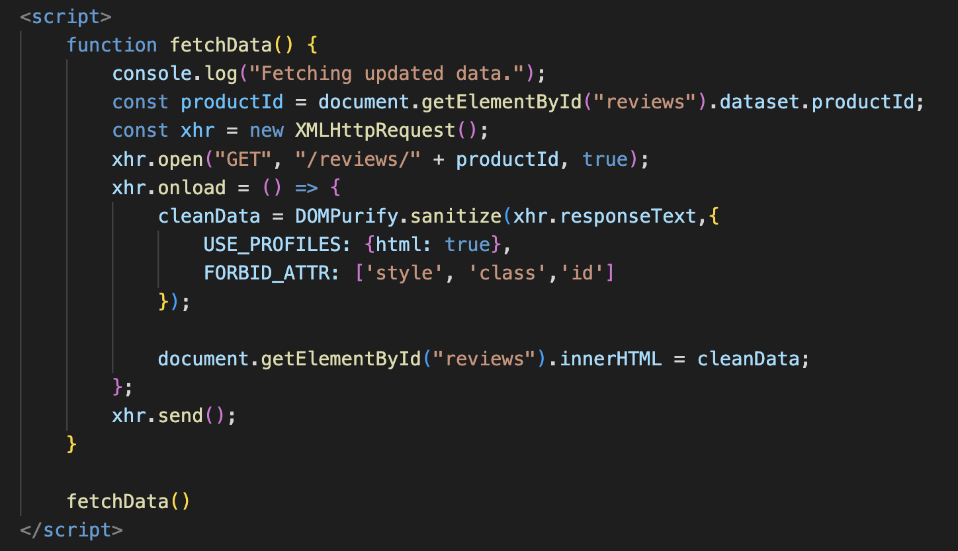
Spoiler
innerHTML usage in app/views/products/show.html.erb
Import DOMPurify
Use Profiles
FORBID_ATTRS
Modify CSP

Slide 71
Improving Open Source
Utilizing what we’ve learned to improve OSS

Slide 72
Brainstorming Improvements to OSS
Depth
Find one project, learn it well, and identify improvement
Ex. Improving Mastodon’s URL Parsing, Test Suites and HTTP Requests
Breadth
Find one vulnerability type, search many projects, and improve them all
Ex. Improving URL Parsing Regex’ across the Ecosystem

Slide 73
Discovering areas of opportunity
Search GitHub Topics!
https://github.com/topics
Filter by language
Sort by stars!
Improve software that you use!
DOMPurify
Mastodon
Discord
Utilize Code Search to find easy patterns
Unescaped Regex
DOMPurify.sanitize
<script>alert(1)</script>

Slide 74

Key Takeaways
Incidents Happen – Design to improve incident response.
Prevent Regression – Never waste a good incident. Write tests!
Support Extension and Exemption – Exceptions will be needed, design for them.
Understand your libraries and compensating controls

Slide 75
Anti-Patterns In Auth(N|Z)
adfasdf

Slide 76
Exercise: Weak Admin Authentication
Problem: We’ve heard rumors that our admin authentication is weak and easily broken.
Mission:
Determine how admin users are authenticated
Break the authentication to access the data
Hints:
http://127.0.0.1:3000/admin/categories
App/controllers/admin_controller.rb

Slide 77
Improvements?
Shared Secret could be stronger
Comparison should be constant-time
Verbose message provides details
Should utilize Access Control
Role Based
Attribute Based

Slide 78
A beginner's guide to constant-time cryptography
https://www.chosenplaintext.ca/articles/beginners-guide-constant-time-cryptography.html

Slide 79
We’re not here to implement RBAC

Slide 80
Exercise: Improve Admin Authentication
Problem: We can improve our admin auth system
Mission:
Unify messaging to ensure details are not leaked
Implement constant-time comparison
Rotate the secret, but support backward compatibility
Write a test!
Hints:
One variable to rule them all
ActiveSupport::SecurityUtils.secure_compare
You choose the value, but continue to support the previous one

Slide 81
Auth Gaps?

Slide 82
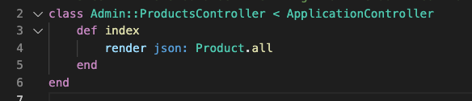
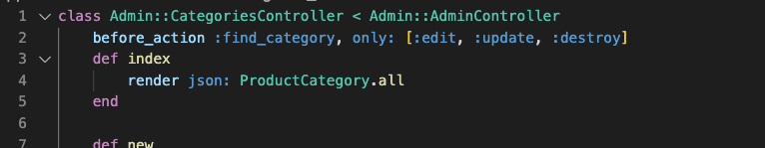
Spot the Difference
They are inheriting from different controllers
Effectively bypassing the admin authn checks.
Verify this against /admin/products
Compare to /admin/categories

Slide 83
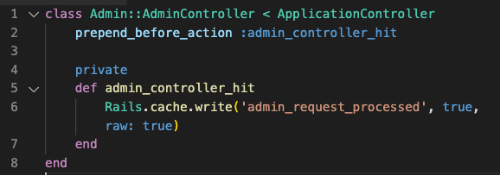
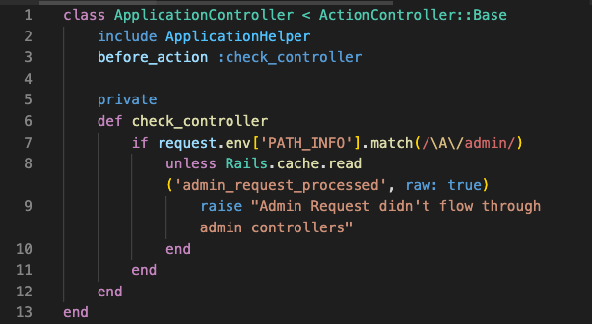
Potential Solution
Base Controller (Application Controller) can guard a route namespace (/admin)
Utilize Routing constraints to run lambda methods

Slide 84
Exercise: Identify Authorization Gaps
Problem: We’ve heard rumors that we are leaking information about user shopping carts.
Mission:
Identify controller and route that is leaking data.
Determine potential patterns of concern (Think: Regex)
Understand the root cause
Hints:
/carts
Carts_controller#index
Require_access!

Slide 85
Spoilers?
Controllers/carts_controller.rb
Insecure usage of Cart.all
Find all calls to Active Record models all method
[A-Z][a-z]*\.all
Require_access! Method does not enforce access
Enforcement required at call site

Slide 86
Misc.
Random musings about Security

Slide 87
Words on Regex
Regular Expressions used regularly for:
Input Validation
Sanitization
Detection
Gaps in Regex result in drastic vulnerabilities.

Slide 88
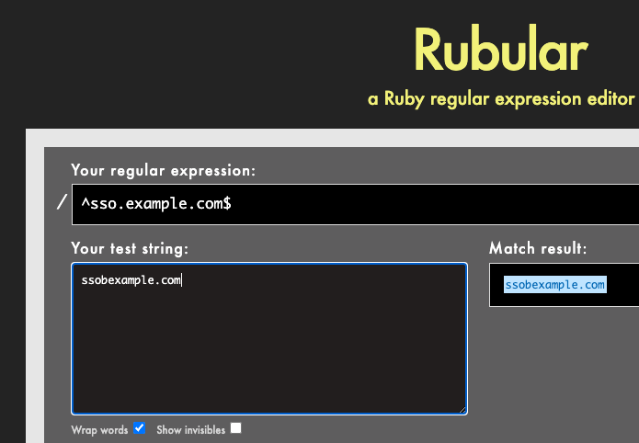
Example Scenario
Validate the hostname for SSO Callback:
Potential Solution:
^sso.example.com$
Possible Attack:
ssobexample.com
Sso.example.com\r\nmalicious.com
Risks of getting this wrong?
Leaked Auth Tokens
Malicious Redirection
Information Disclosure

Slide 89
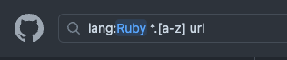
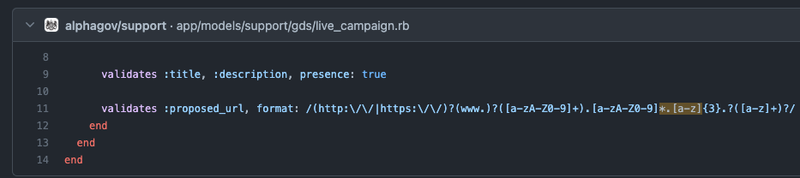
Common Pitfalls
Understand and escape special characters
Un-escaped dots in URL validation regex
[A-z] vs [A-Za-z]
[A-z] is inclusive of special characters: [\]^_`
GitHub doesn’t permit underscores!
Regex DOS (ReDOS)
(a+)+
([a-zA-Z]+)*
Anchoring
Difference in start/end of line, and start/end of string?
In Ruby: \A and \z vs ^ and $

Slide 90
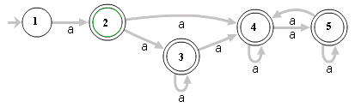
Preventing ReDoS
Time bounding
Restrict regular expressions to a constant timeout (1 second, etc.)
Avoid processing user-provided regular expressions
Understand framework-level solutions and performance thereof
In Ruby, use Scan or Grep instead of Match
Avoid nested quantifiers
(a+)*

Slide 91
Day One Wrap Up!
Expectations for Tomorrow
Group Activity
More code review
More engineering
More hacking
Group activity!
Contributing to Open Source
Think about OSS projects that are meaningful to you

Slide 92
Defense-in-Depth Engineering
John Poulin
@forced_request

Slide 93
Workshop Outline
Day One
Introduction
Environment Overview
Technical Content
Designing for Incidents
Preventing Regression
Designing for Extensibility
Anti-patterns in Auth(n|z)
Misc.
Day Two
Recap
Technical Content
CSRF
Understand your Libraries
SSRF
Group Activity
Conclusion

Slide 94
URLs, Parsers, HTTP, oh my

Slide 95
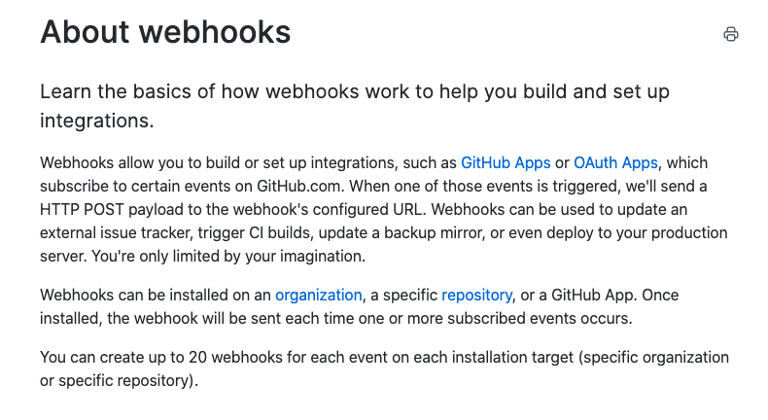

https://docs.github.com/en/developers/webhooks-and-events/about-webhooks

Slide 96
Threats?
Arbitrary HTTP Request (Server-Side Request Forgery)
Internal Requests
Abusive external requests
HTTP response splitting
Authentication / Authorization

Slide 97
Server-Side Request Forgery
In a Server-Side Request Forgery (SSRF) attack, the attacker can abuse functionality on the server to read or update internal resources. The attacker can supply or modify a URL which the code running on the server will read or submit data to, and by carefully selecting the URLs, the attacker may be able to read server configuration such as AWS metadata, connect to internal services like http enabled databases or perform post requests towards internal services which are not intended to be exposed.

Slide 98
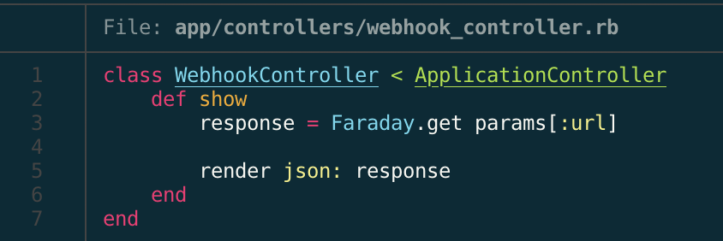
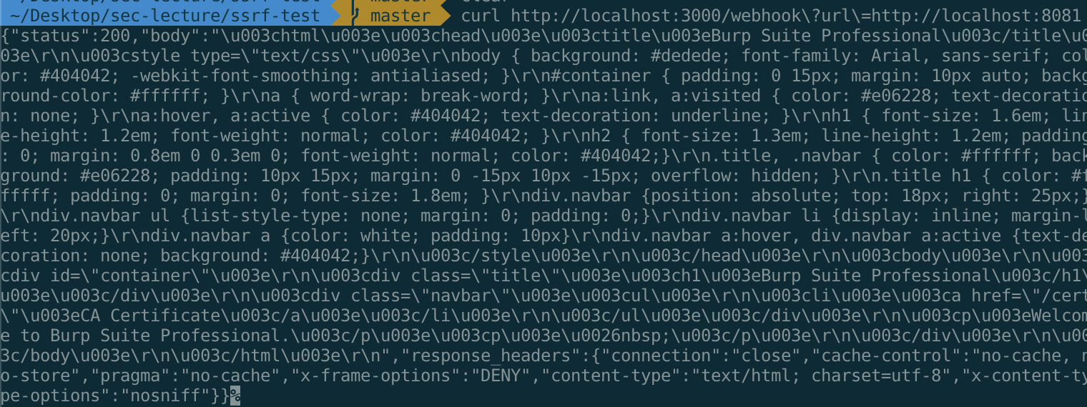
Example
http://SERVER/webhook?url=http://localhost:8081

Slide 99
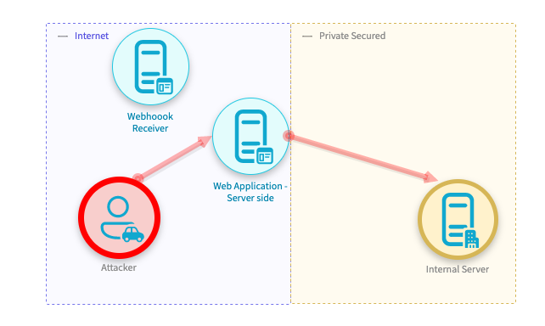
SSRF to Internal Server

Slide 100

SSRF Case Study
July 2019 Capital One was breached
Over 100 million affected
140,000 Social Security Numbers
80,000 Bank Accounts

Slide 101
AWS Metadata Endpoint
Cloud services have metadata endpoints (http://169.254.169.254)
Accessible only from the machine.
AWS can grant roles to instances.
These credentials can be gathered from the metadata service.
http://169.254.169.254/latest/meta-data/iam/security-credentials/role-name

Slide 102
Overly Privileged Credentials
Compromised instance had a role: ISRM-WAF-Role
Role permitted access to Sensitive data in S3
Researcher disclosed to Capital One via Bug Bounty program

Slide 103
SSRF Mitigation?
URL validation as a defense-in-depth measure
Require HTTPS
Ensure specific hostname
Use service-to-service authentication on internal services
Reduces risk, but does not mitigate issue
Require external proxy for network connections
Notes:
URL Validation: ensuring it’s not an IP address, ensuring it’s not an internal host, or ensuring it’s one of a set of allow-listed hosts.

Slide 104
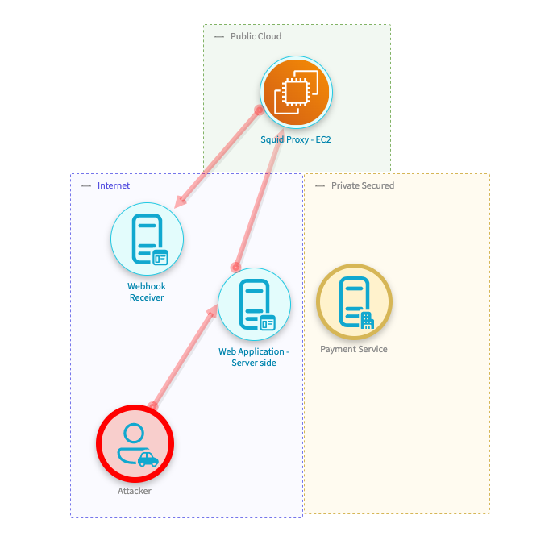
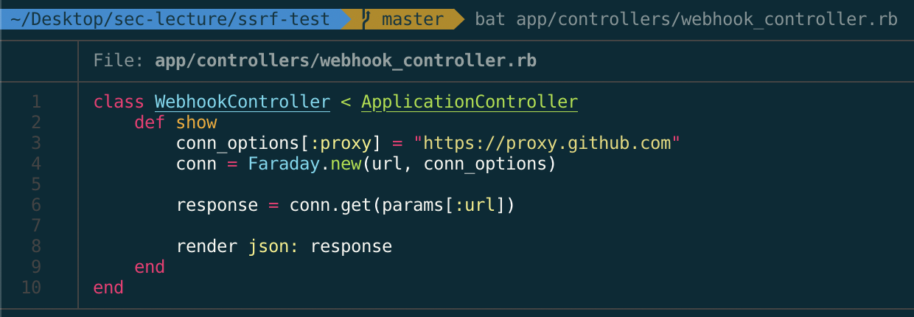
Proxy Usage

Slide 105
Service-to-Service Auth
Require authentication between internal services
Shared key
Request Signing (HMAC)
Mutual TLS
Notes:
MAC vs Hash? – Does anyone know the difference?
Mac is often computed with hashing functions, such as SHA, but offers an additional element of authentication via the usage of a shared key.

Slide 106
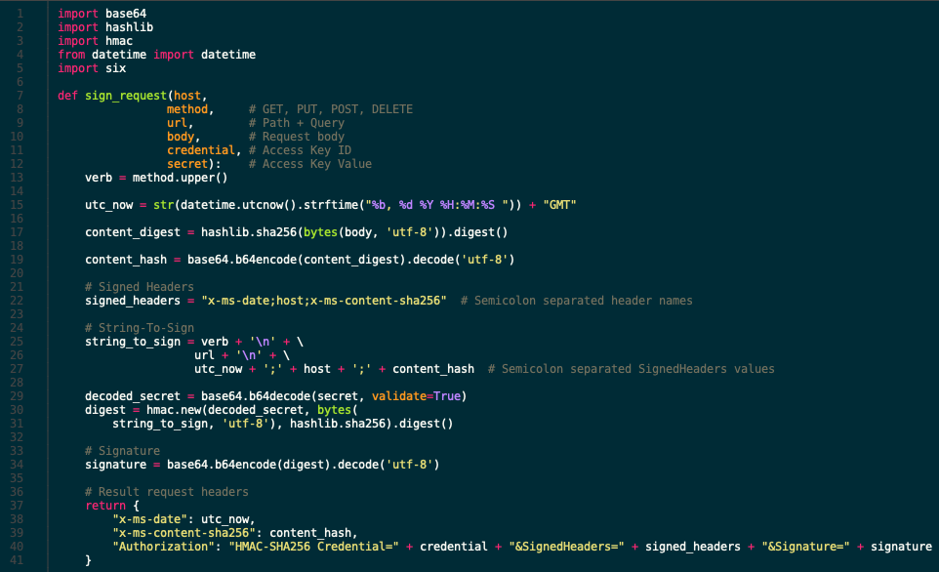
Service-to-Service Auth
Relies on shared secret for authentication.
Includes multiple-factors to ensure tamper resistance.
Includes timestamp to prevent replay attacks.
Server verifies the request
https://docs.microsoft.com/en-us/azure/azure-app-configuration/rest-api-authentication-hmac

Slide 107
AWS’s Solution
November 2019 – AWS released IMDSv2
New Metadata service requiring:
PUT request to establish session
Token passed via HTTP request headers in secondary HTTP request
Notes:
New endpoint requires two requests: one to grab a set of credentials and another to request the service
Harder and less likely to inject HTTP headers into a request

Slide 108
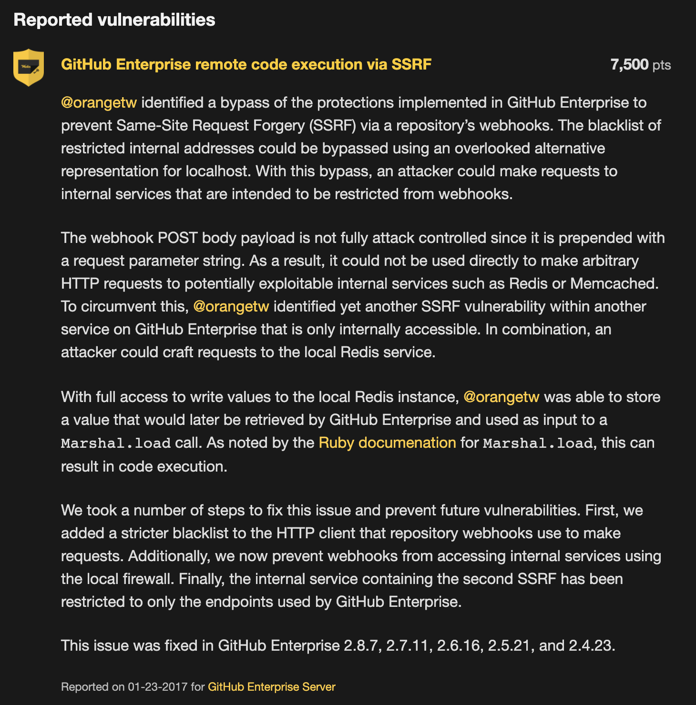
Limited SSRF via Webhooks
SSRF to internal service
Store payload in redis
Insecure Code Execution -> RCE
$15,000 Payout
https://bounty.github.com/researchers/orangetw.html
Notes:
Worth mentioning that this attack was aided through source code access.

Slide 109
Exercise: Mitigate SSRF
Problem: There is a SSRF vulnerability that needs to be mitigated. Requests should only ever be delivered to external hosts.
Mission:
Discover SSRF Vuln
Implement a proxy
Hints:
Identify any HTTP request libraries in Models
Research Net::HTTP to figure out how to set a proxy
There’s an example somewhere in our codebase

Slide 110
Can we do better?

Slide 111
Let’s improve our HTTP Library
Internal Requests
Cannot be external
Must have service-to-service auth
Must target a defined set of hostnames
Must utilize HTTP or HTTPS
External Requests
Cannot be internal
Must have rate-limiting
Must utilize HTTPS

Slide 112
Exercise: Improve!
Problem: We addressed a single SSRF instance but need to make ourselves more resilient.
Mission:
Build Lib’s for Internal and External HTTP Requests
Consider how these cases may be different
Hints:
Utilize lib/skate_shop/http_client/external.rb as a starting point
Support GET requests
Emit REQUEST_ID header for Internal

Slide 113
SSRF Improvement Recap
Overload HTTP libraries
Developers must choose if request is internal or external
Perform linting to enforce that HTTP requests be permitted through overloaded libraries.
URL Validation is not sufficient to mitigate SSRF
Internal requests should be easily traceable through telemetry

Slide 114
Cross-Site Request Forgery
Forced-Request.

Slide 115
Cross Site Request Forgery (CSRF)
“Cross-Site Request Forgery (CSRF) is an attack that forces an end user to execute unwanted actions on a web application in which they’re currently authenticated.“
https://owasp.org/www-community/attacks/csrf

Slide 116
CSRF Mitigation
Synchronizer Token pattern
Cross-Origin Resource Sharing (CORS)
SameSite Cookies
Read-only databases

Slide 117
Synchronizer Token Pattern
This is the default mechanism for mitigating CSRF.
Unique, Secret and Unpredictable token
Injected into all forms, submitted in request BODY
Verified on backend before processing request
Many frameworks support this by default
Something you know

Slide 118
Exercise: Rails’ CSRF Protection
Problem: We may have a gap in our CSRF protection
Mission:
Understand Rails CSRF Mitigation
Identify potential gaps
Hints:
verify_authenticity_token
Look for any state-changing route

Slide 119
Cross Origin Resource Sharing
Single Origin Policy
Scripts cannot make requests to other origins
Response headers control behavior
Access-control-allow-origin
Access-control-allow-credentials
Access-control-allow-methods
Prevent CSRF for Ajax requests
Browser solution to prevent sharing across domains

Slide 120
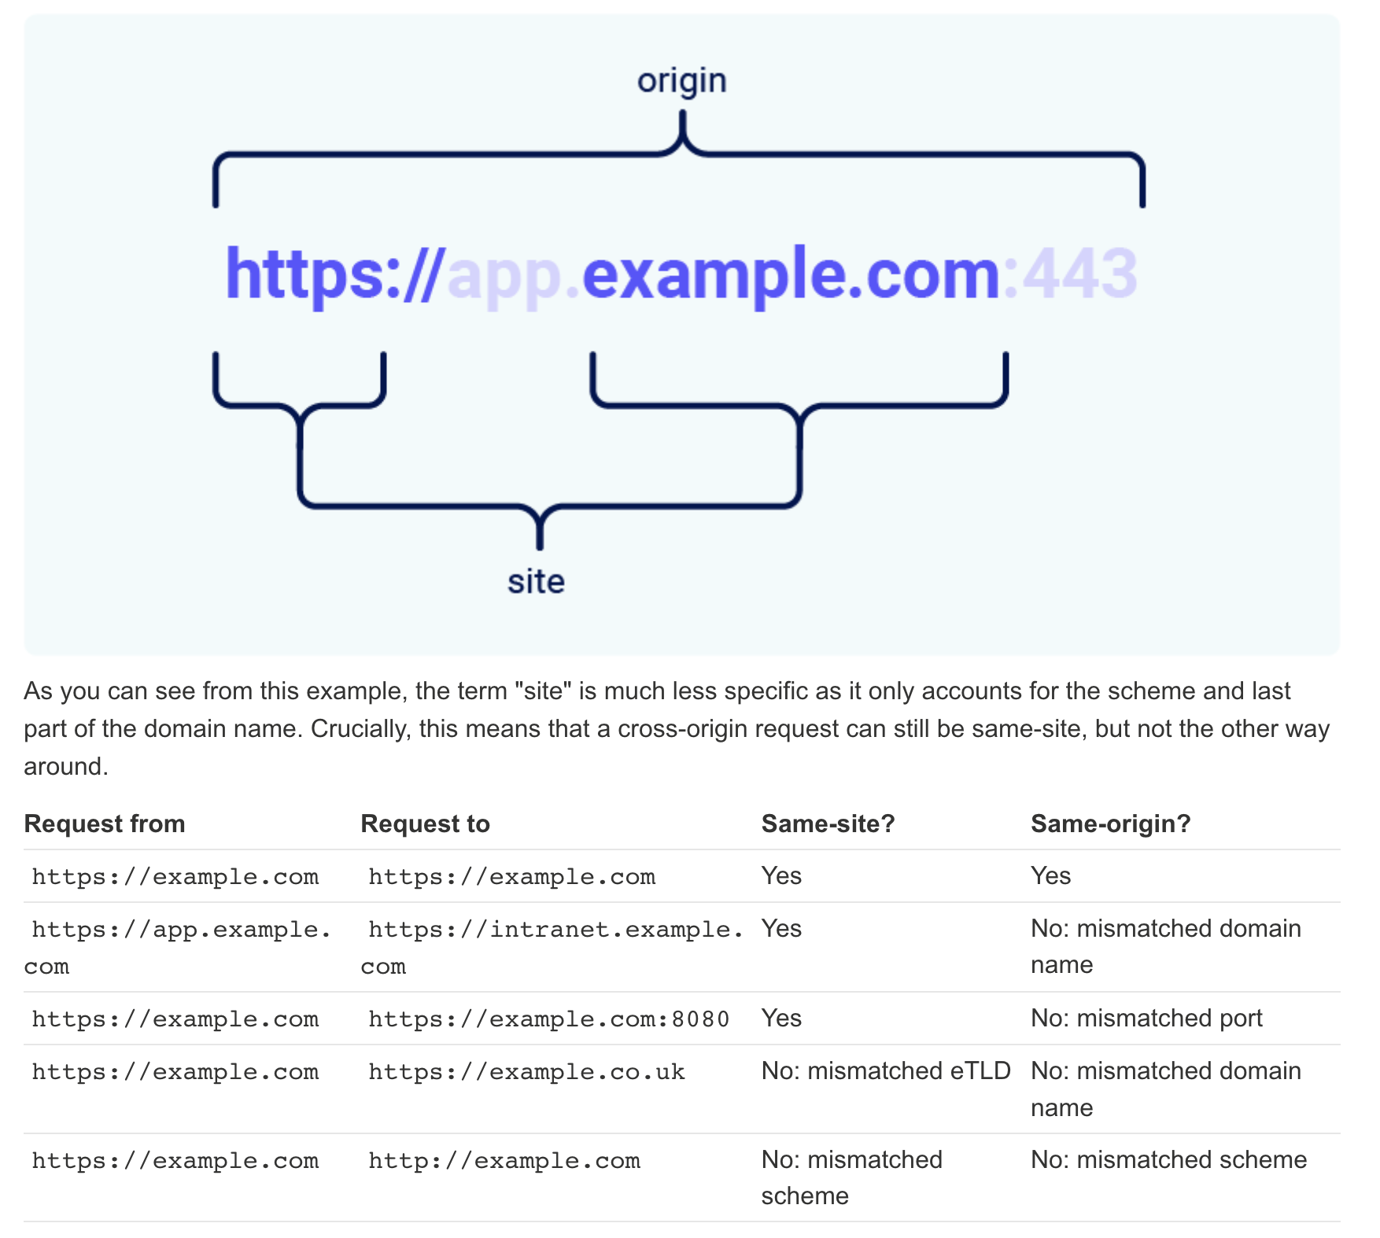
SameSite Cookies
Allow browsers to have tighter control over cookies
Browsers dictate when cookies are sent across origins
I.e., clicking a link from an external website
Directives:
None – No control imposed
Lax – Cookies sent for GET requests for top-level navigation (clicking link).
Strict – No cross-site requests
Chrome enforces Lax by default
State-changing requests MUST not occur over GET.
Recent browser solution to prevent sharing across domains

Slide 121
Read Only Databases
Most frameworks support read/write roles for databases.
State-changing requests should occur via non-GET requests
POST, PATCH, PUTS, DELETE
Utilize middleware to connect to database in reader mode for GET/OPTION
Database transactions will not occur
A complement to SameSite

